Slide 1

Cryptographic Hash Functions

Slide 2
One-Way Functions
A function f: D→R is called one-way if:
∀x∈D, computing f(x) is “easy”
For random x∈D, y=f(x), computing f⁻¹(y) is “hard”
Easy
2⁶⁴ is “easy” for breaking cryptographic applications
For “valid” computation 2⁶⁴ is too slow
Computing f(x) should take fraction of second
Hard - ≥ 2¹²⁸

Slide 3
Attacking OWF
An algorithm A breaks a OWF f if:
On input y=f(x) for random x∈D
A returns x’∈f⁻¹(y)={z|f(z)=y} With High Probability
E.g. 1/2
x and x’ may be unequal

Slide 4
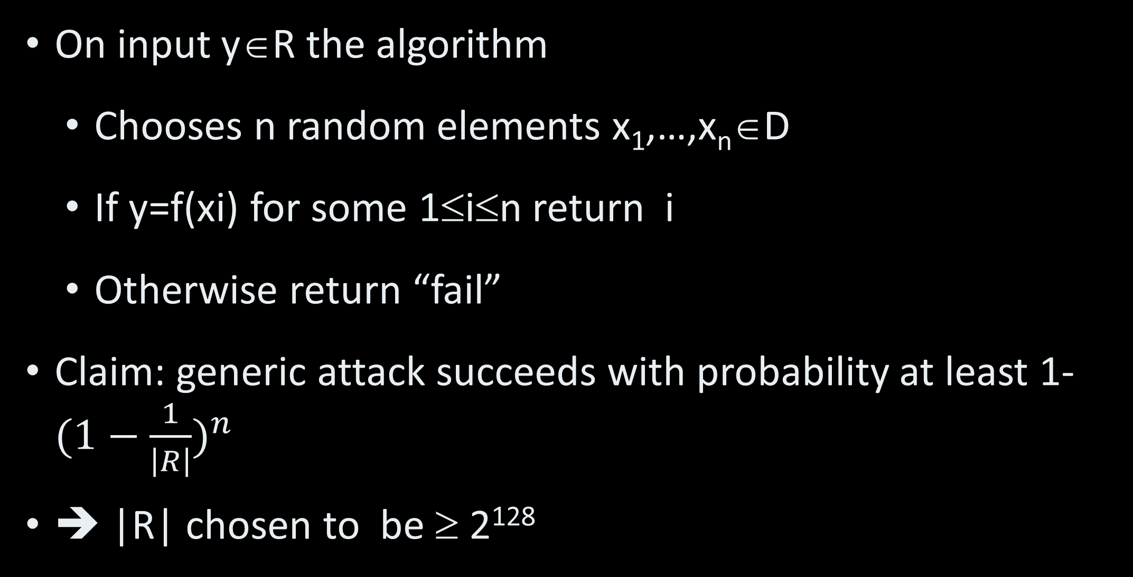
Generic Attack
On input y∈R the algorithm
Chooses n random elements x₁,…,x_{n}∈D
If y=f(xi) for some 1≤i≤n return i
Otherwise return “fail”
Claim: generic attack succeeds with probability at least 1-${(1−\frac{1}{\left|R\right|})}^{n}$
➔ |R| chosen to be ≥ 2¹²⁸

Slide 5
Example of OWF
On input y∈R the algorithm
D={(p,q) | are prime numbers}
The function is f(p,q) = pq
Multiplication is easy – naïve algorithm is O(n²)
Factoring is difficult – simple algorithm is O(2^{n/2}). NFS and ECM are better but not polynomial time
The function f(p,q) = pq (almost) maintains length

Slide 6
Hash Functions
Map large domains to smaller ranges
Easy to compute
Example h: N→{0,1,…,m-1} is defined by h(k) = k mod m
Used extensively for searching in hash tables
Collisions are resolved by several possible means – chaining, open hashing etc.

Slide 7
Cryptographic Hash Functions
Collision resistance
Hard to find collisions
A function h: D→R is called collision resistant if it is hard to find x, x’ such that x’≠x but h(x)=h(x’)
Note: given certain constraints
Collision-resistant hash function is OWF
Cryptographic Hash Function = Collision Resistant Hash Function (CRHF)

Slide 8
Attacking CRHF
An algorithm A breaks a CRHF h if
A outputs x, x’, x≠x’, h(x)=h(x’)
How hard is a generic attack against CRHF?

Slide 9
OWF Visually
Domain
f(x) - easy
Range
x
y
f⁻¹(y) - hard

Slide 10
CRHF Visually
Domain
h(x)=y
Range
x
y
Hard!
x’
h(x’)=y

Slide 11
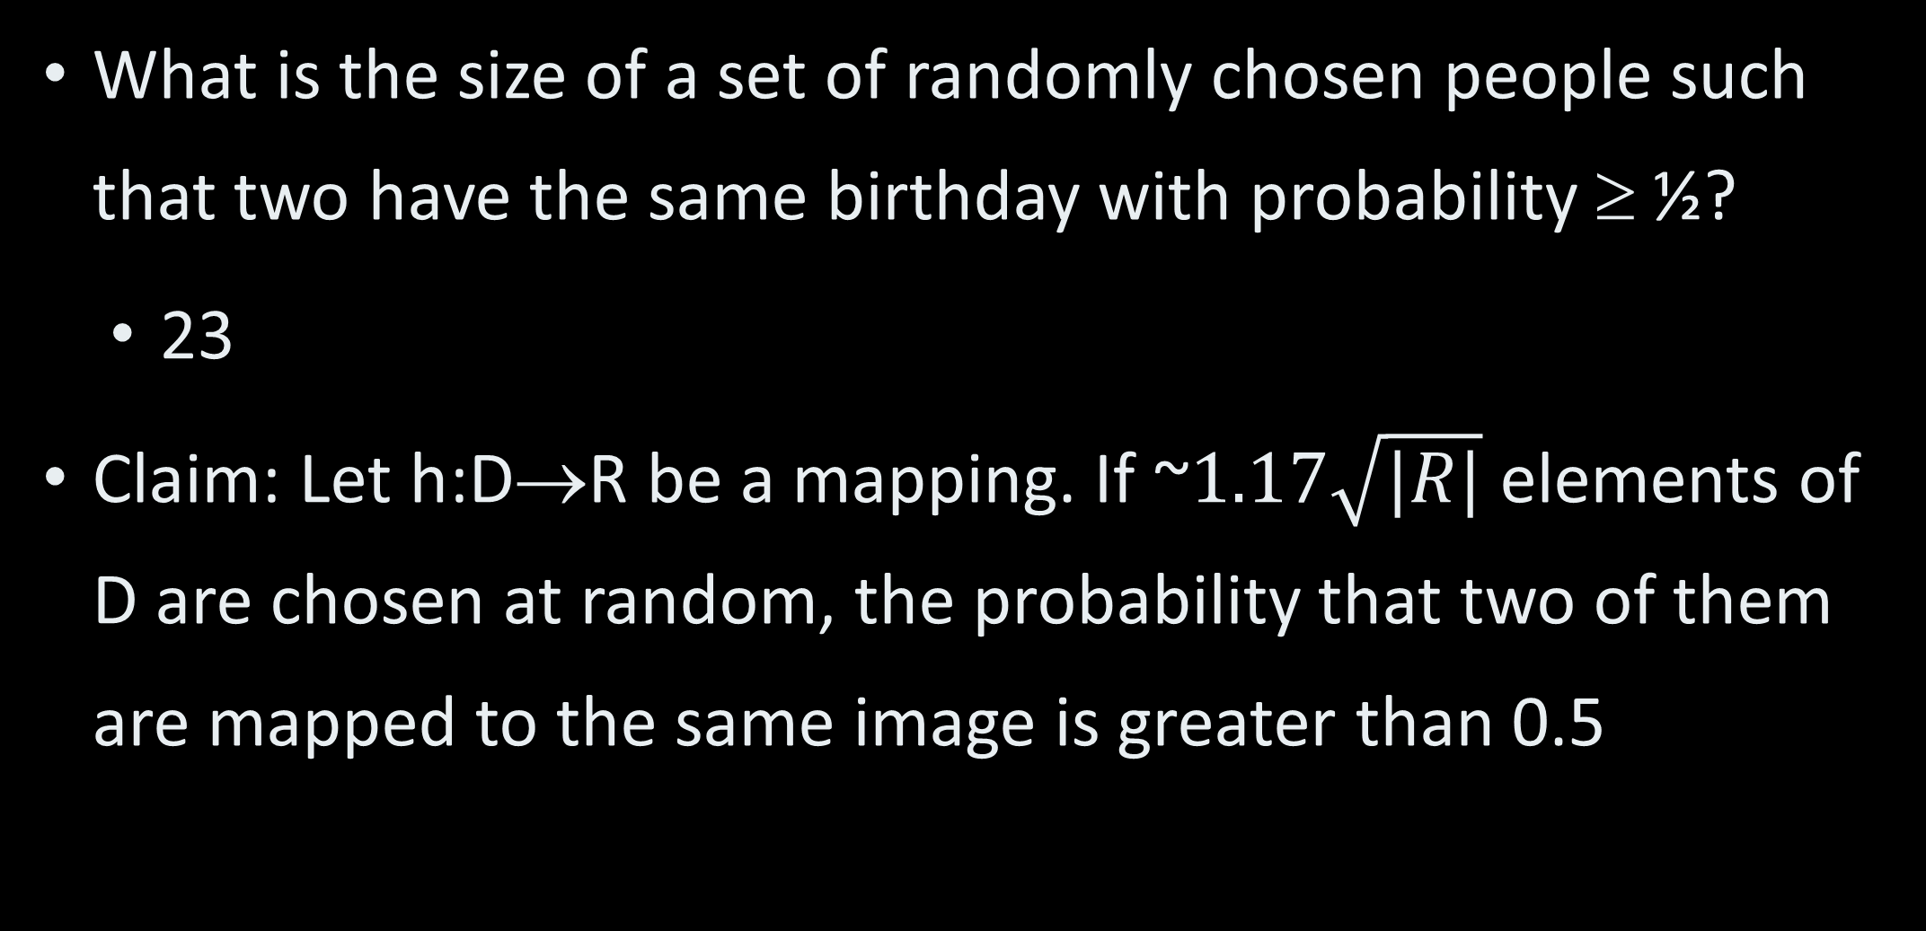
Birthday Paradox I
What is the size of a set of randomly chosen people such that two have the same birthday with probability ≥ ½?
23
Claim: Let h:D→R be a mapping. If ~$1.17\sqrt{|R|}$ elements of D are chosen at random, the probability that two of them are mapped to the same image is greater than 0.5

Slide 12
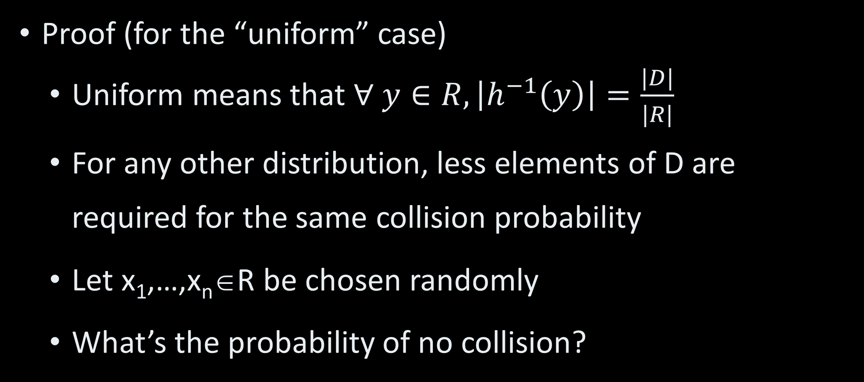
Birthday Paradox II
Proof (for the “uniform” case)
Uniform means that $∀ y∈R, \left|h^{−1}\left(y\right)\right|=\frac{|D|}{|R|}$
For any other distribution, less elements of D are required for the same collision probability
Let x₁,…,x_{n}∈R be chosen randomly
What’s the probability of no collision?

Slide 13
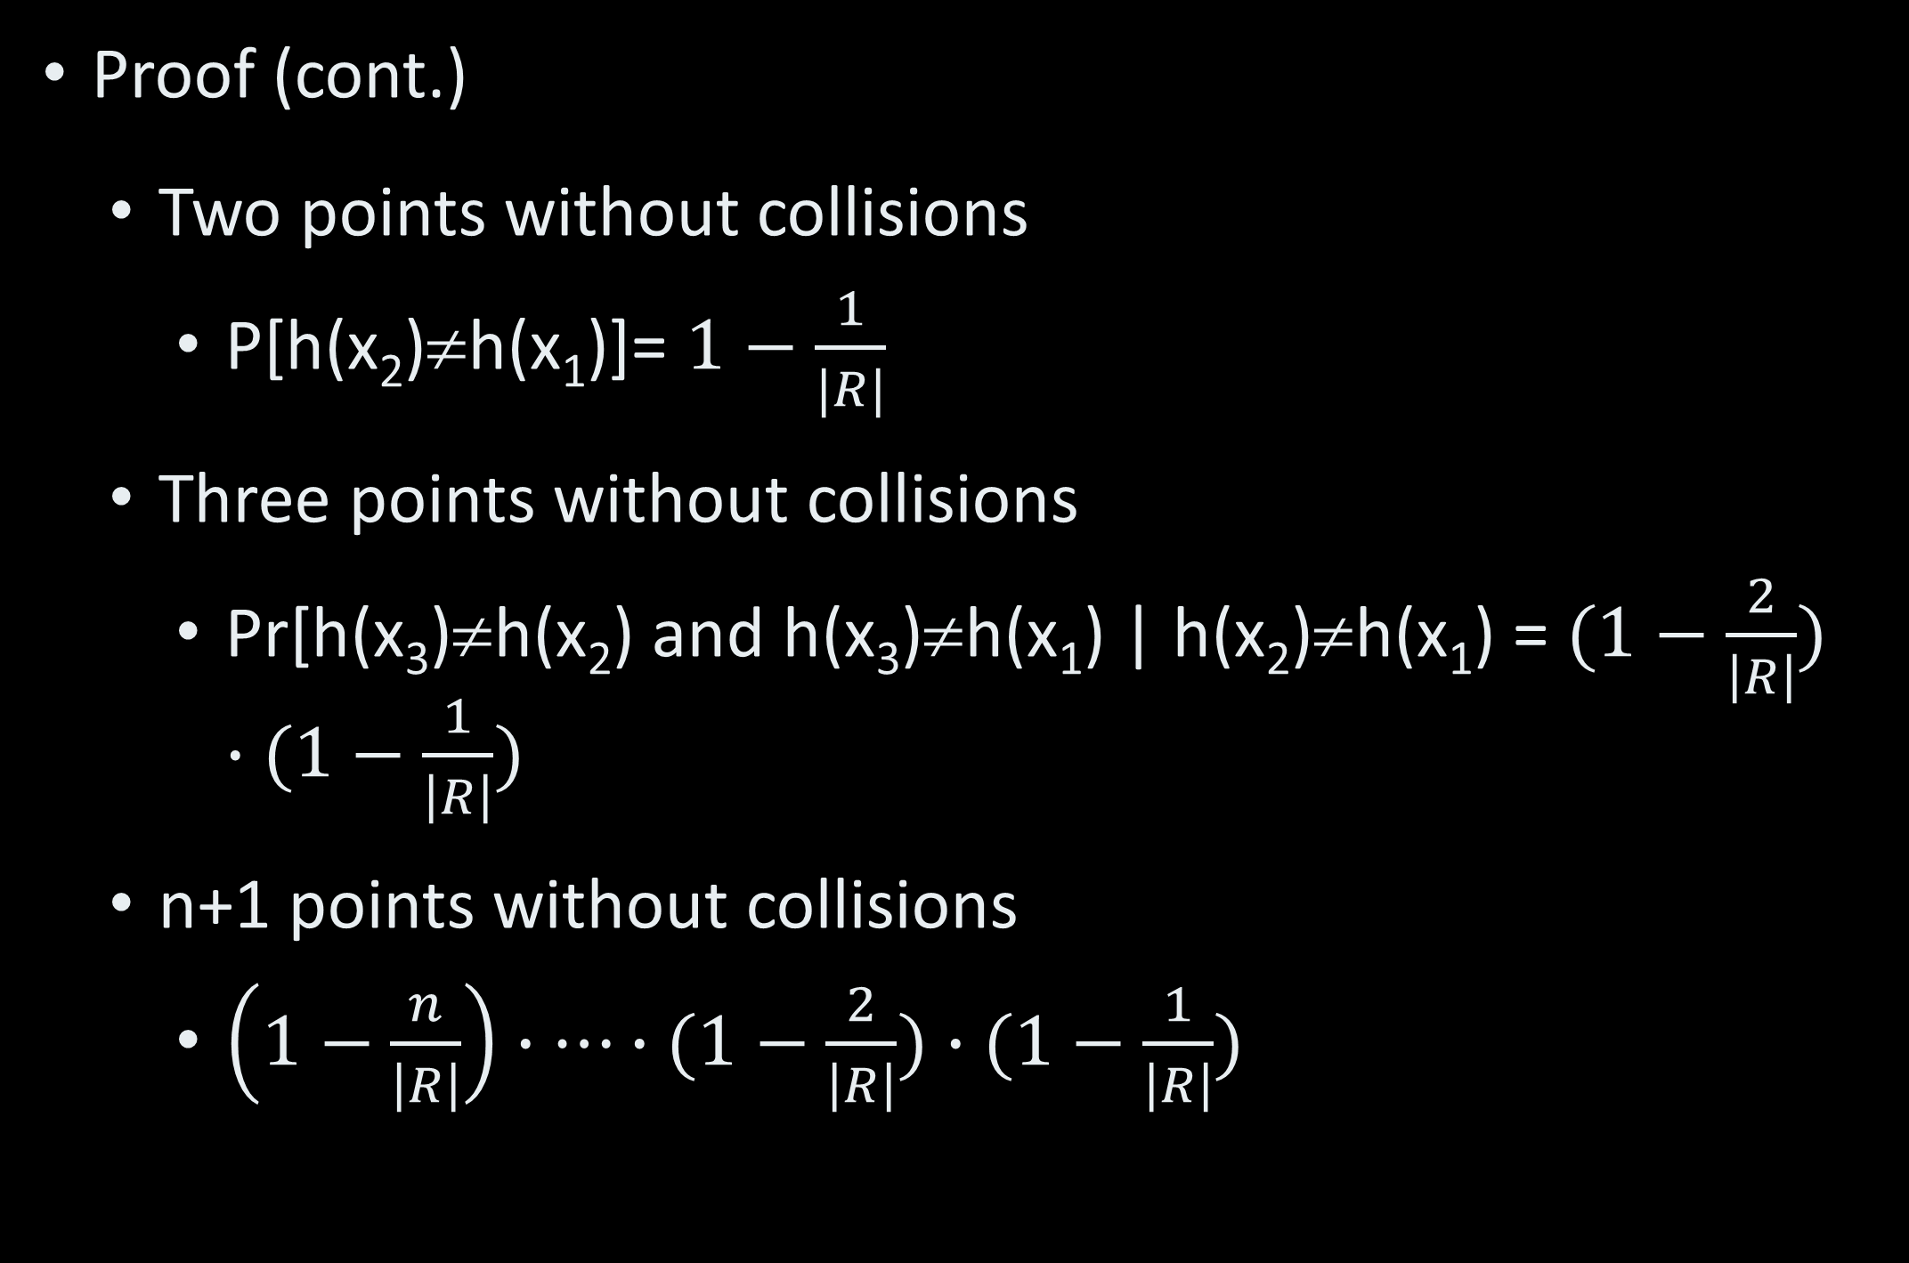
Birthday Paradox III
Proof (cont.)
Two points without collisions
P[h(x₂)≠h(x₁)]= $1−\frac{1}{|R|}$
Three points without collisions
Pr[h(x₃)≠h(x₂) and h(x₃)≠h(x₁) | h(x₂)≠h(x₁) = $(1−\frac{2}{\left|R\right|})∙(1−\frac{1}{\left|R\right|})$
n+1 points without collisions
$\left(1−\frac{n}{\left|R\right|}\right)∙⋯∙(1−\frac{2}{\left|R\right|})∙(1−\frac{1}{\left|R\right|})$

Slide 14

Birthday Paradox IV
Proof (cont.)
By Taylor series
e^{-x}≥1-x
Probability of no collision in n+1 points
$≤e^{\frac{−1}{\left|R\right|}}∙e^{\frac{−2}{\left|R\right|}}∙⋯∙e^{\frac{−n}{\left|R\right|}}=e^{\frac{−n(n+1)}{2|R|}}$

Slide 15
Birthday Attack
Goal
Generic method to find collisions in hash functions
Attack
Pick ~|R|^{1/2} random elements from D
Compute hash for all of them
Check collisions
Time – O(~|R|^{1/2}), error ≤ ½

Slide 16
Probability Amplification
To improve probability
Repeat process k times
Probability of success 1-2^{-k}

Slide 17
CRHF Constructions I
Common domain – {0,1}*
Common range – {0,1}^{m} for m=2*security parameter
E.g. m=256 or m=512
Range size is twice key size for encryption with similar security

Slide 18
CRHF Constructions II
Common approach
Hash strings of restricted size
Extend to arbitrary length
Some common designs
Merkle-Damgard
Sponge
Block cipher chaining

Slide 19
Merkle-Damgard I
Compression function H:{0,1}^{n+m}→{0,1}^{m}
Typical value for n – 512 bits
Typical values for m
160
224
Current recommendation - 256, 384, 512
Extension via chaining to h:{0,1}*→{0,1}^{m}

Slide 20
Merkle-Damgard II
Message M=M₁,M₂,…,M_{k}∈({0,1}^{n})^{k}
Compression function
m bits
H
m bits
H
H
IV
…
h(M)
…
M₁
n bits
M₂
M_{k}

Slide 21
Merkle-Damgard III
IV Is typically constant
Unlike most encryption schemes
Padding of message
To multiple of n
Typically encodes message length
Can we argue security?

Slide 22
Proving security
Three main methods to prove that system is secure:
Unconditionally
Example – OTP
Secure against all known attacks
AES
Hash compression function
Reduction to security of another scheme
Merkle-Damgard

Slide 23
Security Reduction
Form:
If scheme A is secure then scheme B is secure
Equivalently:
If B is insecure then A is insecure
➔Given an attack breaking B, there is an attack to break A
Attack on A uses attack on B as oracle

Slide 24
Merkle-Damgard Sec. II
Proof (cont.)
Construct algorithm B that finds collision in H
B calls A
Obtains k, M, N
Searches for collisions in blocks of M, N

Slide 25
Merkle-Damgard Sec. III
H
a_{k-1}
H
a_{k}
H
IV
…
h(M)
a_{k}=b_{k}. Analyze (a_{k-1},M_{k-1}) & (b_{k-1},N_{k-1})
Case 2:
(a_{k},M_{k})=(b_{k},N_{k})
h(M)=h(N)
Case 1:
(a_{k},M_{k})≠(b_{k},N_{k})
➔ H is not CR!
…
M₁
M_{k-1}
M_{k}
H
b_{k-1}
H
b_{k}
H
IV
…
h(N)
…
N₁
N_{k-1}
N_{k}

Slide 26
Merkle-Damgard Sec. IV
Proof (cont.)
(a_{j},M_{j}) ≠ (b_{j},N_{j}) for some 1≤j≤k
Since M≠N
➔ H is not collision-resistant
Theorem: If H is collision-Resistant then h is collision-resistant

Slide 27
Sponge I
Message M, |M|=kr
Divide into k blocks
Each block is of length r bits
Maintain “sponge” of length b=r+c
r is called the bit-rate
c is the capacity

Slide 28
Sponge II
Two phases
Absorbing:
For i=1,…,k sponge ← f(sponge ⊕ M_{i})
f:{0,1}^{b}→{0,1}^{b} is a permutation
Squeezing: repeatedly perform
Output r bits of sponge
sponge←f(sponge)

Slide 29
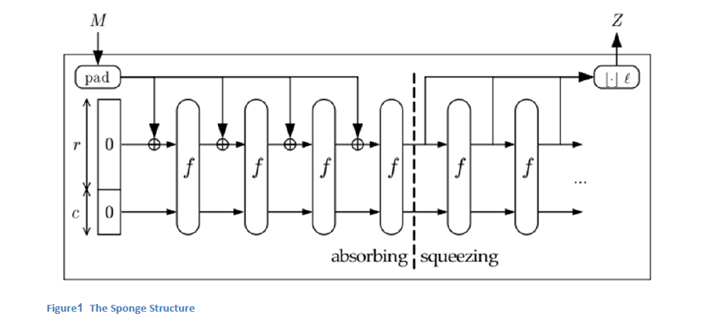
Sponge Diagram
M₁
M₂
M_{k}
Output

Slide 30
Real-World CRHF I
Message M, |M|=kr
MD family: MD-2, MD-4, MD-5
MD=Message Digest
All Merkle-Damgard design
Mostly broken
SHA and SHA-1 – 1990’s standard
Merkle-Damgard
160 bit output

Slide 31
Real-World CRHF II
SHA-2:
SHA-224, SHA-256, 384 and 512
Merkele-Damgard. 2000’s design
SHA-3: KECCAK
Sponge design
2010’s

Slide 32
CRHF Status I
Internet standards (IPSec, SSL, X.509, many others) use SHA-1 (being phased out), SHA-2 and SHA-3.
Multi-block differential attacks:
First block get near collisions (small number of different bits)
Full collision on second block
MD-5 fully broken, large number of collisions of Word, Postscript files and others.

Slide 33
CRHF Status II
Internet standards (IPSec, SSL, X.509, many others) use
SHA-1
First practical collision in 2017 (SHAttered attack, 263 time, 6500 CPU years, 110 GPU years)
SHA-2 - secure
Some (lesser) attacks better than they should be, e.g. against reduced number of rounds or length extension in some situations

Slide 34
Keccak I
SHA-3 effort (paralleling AES process)
2012 choice Keccak
Authors: Bertoni, Daemen, Peeters, Van Assche
May 2014 NIST draft - http://csrc.nist.gov/publications/drafts/fips-202/fips_202_draft.pdf

Slide 35
Keccak II
Output size: SHA3-224/256/384/512
Sponge function:
b=1600 (5X5 array of 64 bits)
In original definition, r=1024, c=576
The internal f function
24 rounds
Each round has 5 strange functions affecting the state

Slide 36
Integrity / Authentication

Slide 37
Definition I
Authentication (Signature) algorithm - A
Verification algorithm - V
Authentication key – k
Verification key – k’
Message space (usually binary strings)
Every message between Alice and Bob is a pair (m, A_{k}(m))

Slide 38
Definition II
In the symmetric case
k=k’
The authentication algorithm is usually called Message Authentication Code (MAC)
In the a-symmetric case
k≠k’
The authentication algorithm is called “Digital signature”
A_{k}(m) is frequently denoted SIG_{k}(m)

Slide 39
Properties of Auth.
Correctness
V_{k’}(m,A_{k}(m))=True
Security – hard to find legal pair (m,A_{k}(m)) without knowing k or already having the pair.
Performance - A_{k}(m) is as short as possible

Slide 40
Verifying MAC
Symmetric key k
Authenticator sends
(m,A_{k}(m))
Verifier receives
(m,s)
Checks whether s=A_{k}(m)

Slide 41
Verifying MAC
Symmetric key k
Authenticator sends
(m,A_{k}(m))
Verifier receives
(m,s)
Checks whether s=A_{k}(m)

Slide 42
Adversarial Model
Known message
Eve receives (m₁,MAC_{k}(m₁)),…, (m_{n},MAC_{k}(m_{n}))
Chosen message
Eve chooses m₁,…,m_{n}
Eve receives (m₁,MAC_{k}(m₁)),…, (m_{n},MAC_{k}(m_{n}))
Goal: generate (m,MAC_{k}(m)) for
m≠m_{i} for all 1≤i≤n

Slide 43
HMAC Attempts I
Goals
Combine message and key, hash and produce MAC
Work with any cryptographic hash function
First attempt: MAC_{k}(m)=h(k||m)
But: message extension attack
If h is Merkle-Damgard
Given MAC_{k}(m) produce MAC_{k}(m||m’)

Slide 44
HMAC Attempts II
Second attempt: MAC_{k}(m)=h(m,k)
One collision leads to many bad MACs

Slide 45
HMAC I
Proposed in 1996 by [BCK]
Receives as input a message m, a key k and a hash function h
Outputs a MAC by:
HMAC_{k}(m,h)= h(k⊕opad, h(k⊕ipad,m))
ipad and opad different constant strings
Claim [BCK]: HMAC can be broken if and only if a collision is found for h

Slide 46
HMAC II
HMAC widely used in communication standards
IPsec
TLS
Many others

Slide 47
Chaining MAC (CMAC)
IV
P₁
P_{n}
E_{k}
…
E_{k}
E_{k}
C₁
C_{n}
MAC

